Slide 1


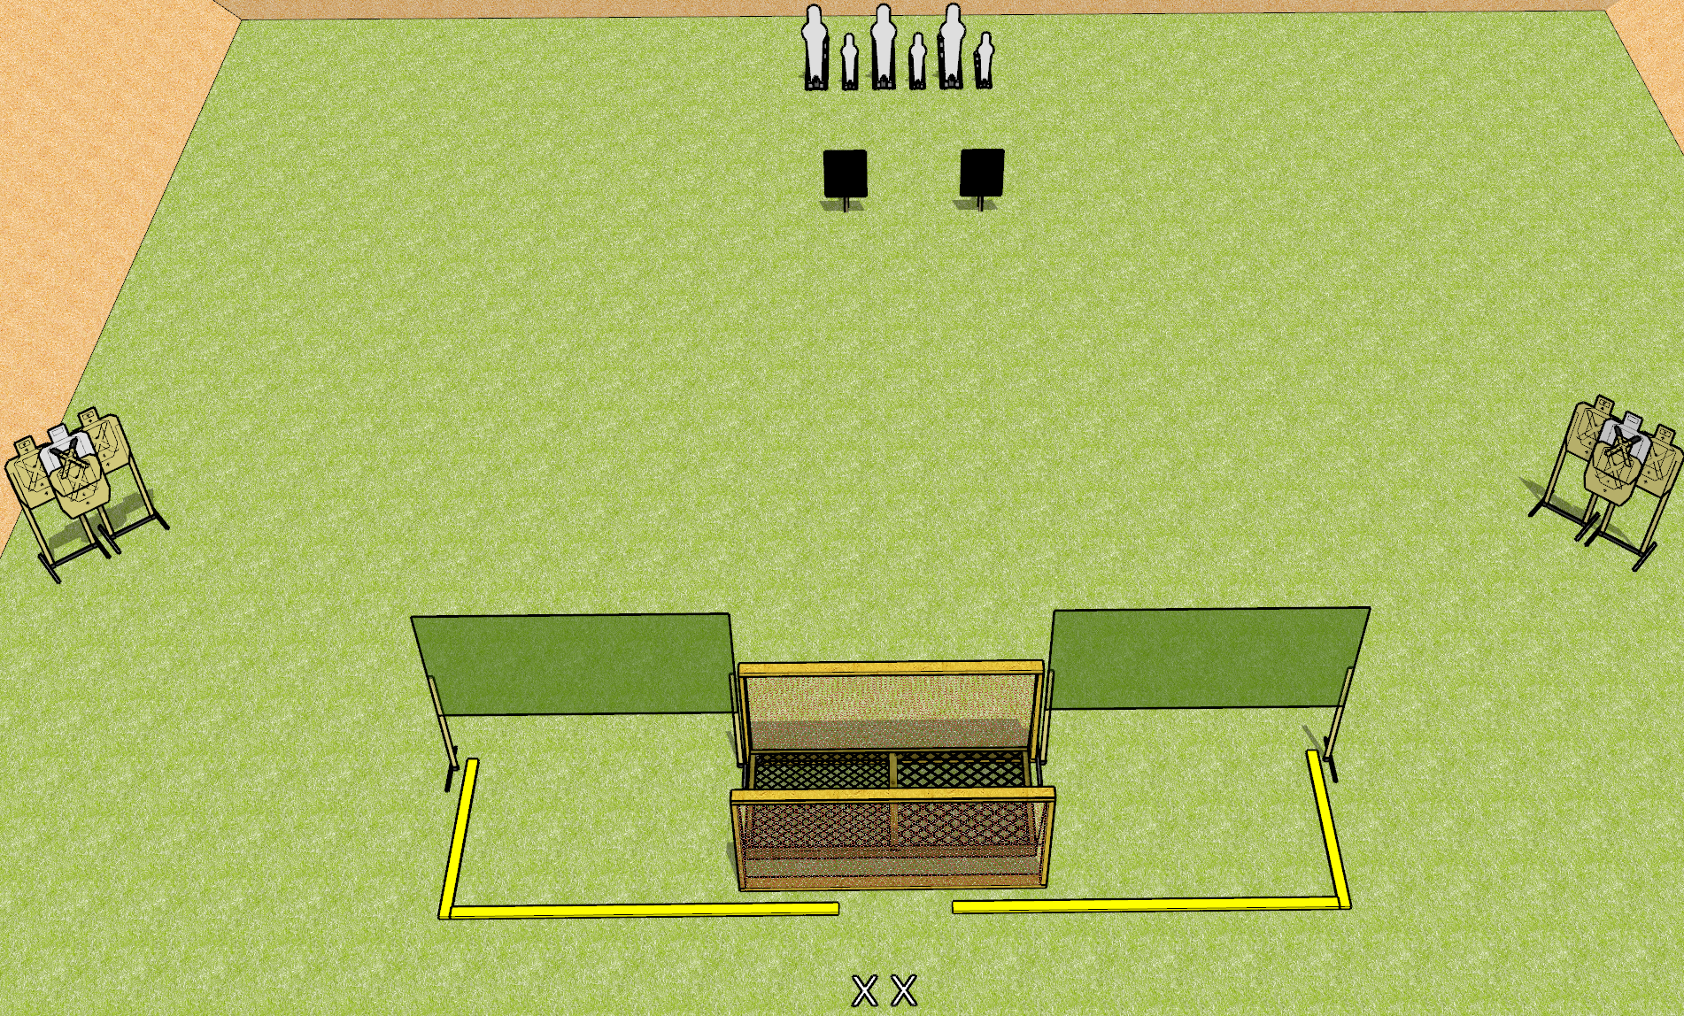
 | Dothan Gun Club – USPSA Match Motion Sickness Course Designer : Daryl Shirah/Drew Coleman
START POSITION : Standing with both feet on X’s
GUN READY CONDITION : Pistol loaded and holstered. PCC shouldered, safety on, pointed at orange cone. |  | SCORING: Comstock, X rounds TARGETS: X paper, X Steel SCORED HITS: Best 2 on paper, steel until down START-STOP: Audible, last shot RULES: Failing to use Strong Hand Only for the final target array will result in one procedural penalty for EACH shot fired.
STAGE PROCEDURE: Engage targets as they become available from within the fault lines. Poppers 1-6 must be engaged fully from the bridge, unsupported. Last target array must be engaged Strong Hand Only

